Slide 1
NEUE FISCHE · CAPSTONE I · 2025/26
RAG The Research
With a knowledge based AI Assistant
PaperForge
Thomas
Viktor
Markus

Slide 2

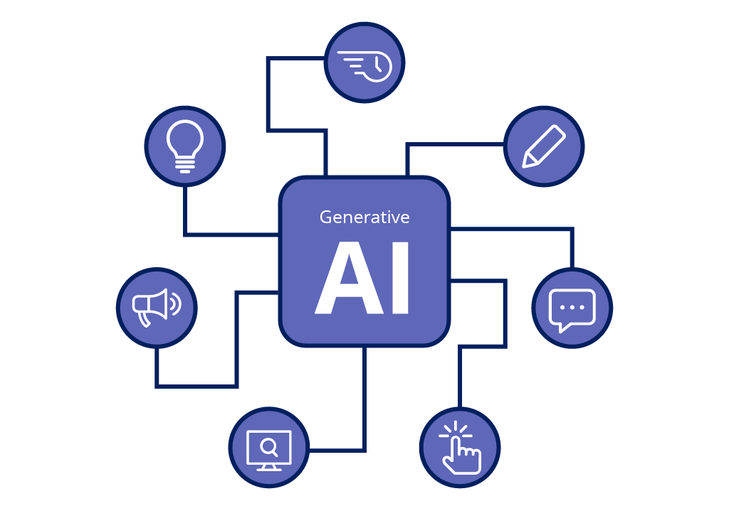
BRAVE NEW AI

Slide 3
WHEN YOU ASK AN LLM
You get:
Access to an immense amount of data
Reasoning capabilities
Context based answers
Summaries

Slide 4

WHEN YOU ASK AN LLM
You get:
Access to an immense amount of data
Reasoning capabilities
Context based answers
Summaries
End of Story?

Slide 5
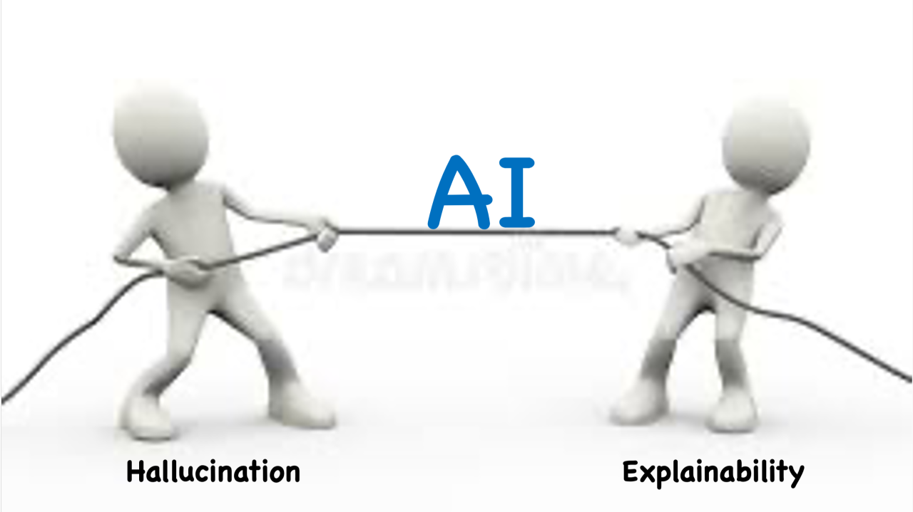
PROBLEM 1
Reliability

Slide 6

WHY IS RELIABILITY A PROBLEM FOR AI?
No Traceability, No Reliability

Slide 7

PROBLEM 2
Data Availability / Security

Slide 8
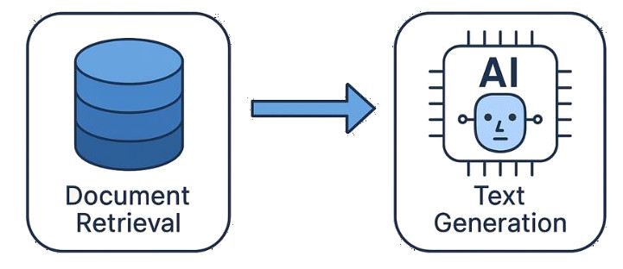
THE BEST OF ALL WORLDS
Retrieval Augmented Generation RAG

Slide 9


THE BEST OF ALL WORLDS
Retrieval Augmented Generation RAG

Slide 10
OUR GOAL
Building a Locally Running RAG from Scratch
Proof of concept for many business applications
Make sensitive data reliably accessible
Harness the capabilities of LLMs
  Search files
  Inquire about customer data, bills, the secret ingredient
  “When did we switch the supplier”

Slide 11

OUR USE CASE
The PubMed Scientific Database
National Library of Medicine (NIH), USA
Clinical studies, medicine, life sciences
Available in XML

Slide 12
OUR USE CASE
The PubMed Scientific Database
National Library of Medicine (NIH), USA
> 40 million papers
Clinical studies, medicine, life sciences
Available in XML
The PubMed Q&A Dataset
1000 Questions and Answers
Yes/No + Full Text
Only 69 in Open Access

Slide 13

OUR DATA
Reduced to a Feasible Amount of Data
40 million PubMed paper
10 million open access paper
2.3 million paper for non-commercial use
10K paper in our data set (incl. 69 golden paper)

Slide 14
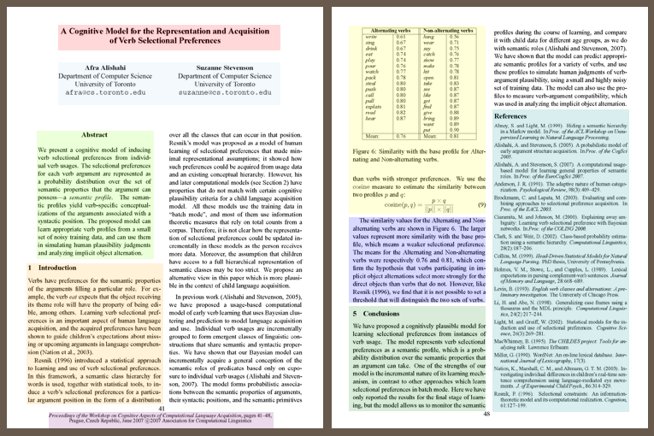
SCIENTIFIC PAPER
The Structure of Knowledge

Slide 15
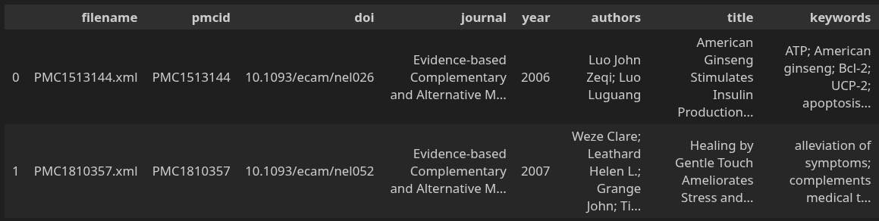
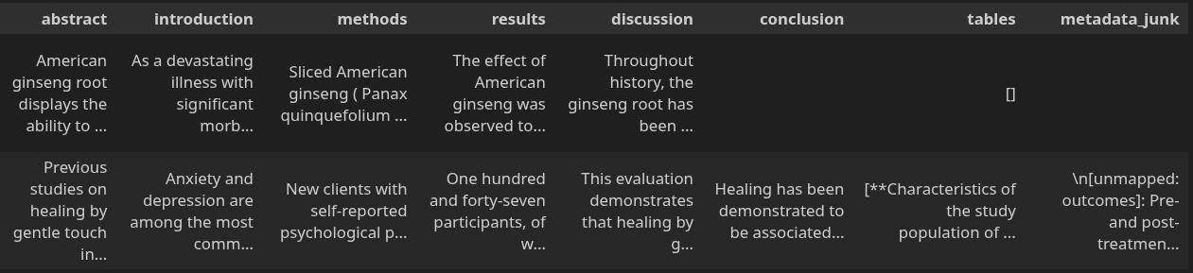
SCIENTIFIC PAPER
The Structure of the Data

Slide 16
PMC Research Assistant
From a Clinical Question to a Reliable Answer
Part I. The Pipeline
Viktor

Slide 17
HOW IT WORKS
The Pipeline — Clinical Question to Answer
First Iteration: Lexicographical Processing Only
Chunking
embedding
Query
Keyword
Search
Top-K
Articles
LLM
Answer
Query → [Lexicographic search only] → Small AI (flan-t5-s)
BM25 is used for retrieval, scoring docs on term frequency; context is being built
LLM Prompt: gets context & query
Small LLM produces an answer
No paper retrieved.
LLM answered from general training only.
No context, no citations.
No paper retrieved.
LLM answered from general
training only.
no context, no citations.

Slide 18
HOW IT WORKS
The Pipeline — Clinical Question to Answer
Second Iteration: Lexicographical AND Semantic Processing
Chunking
embedding
Query
Keyword
Search
RRF
(Fusion)
Top-K
Articles
LLM
Answer
Semantic
Search
Query → BM25(lexicographic search) | FAISS (semantic search) → RRF(merge) → Llama 8B
Lexicographic and semantic search branches work in parallel
The resulting output is merged by Reciprocal Ranking Function (RRF) , duplicates are removed
RRF output used as input for
(medium sized) llama 8B LLM
A paper retrieved, but not the most specific.
Answer partially grounded.
Key markers missing.

Slide 19
HOW IT WORKS
The Pipeline — Clinical Question to Answer
Third Iteration: Lexicographical AND Semantic Processing
PubmedBERT
(embedding LLM) +
Semantic
Search
Query
Keyword
Search
RRF
(Fusion)
Top-K
Articles
LLM
Answer
Query → BM25(lexicographic search) | PubmedBERT + FAISS (semantic search) → RRF(merge) → Llama 70B
PubMedBERT: specialized LLM
  Used for the medical and biological fields likeliness.
  converts medical and biological tokens into embeddings
  Trained on PubMed documents.
Bigger LLM (Llama 70b)
Relevant papers retrieved. Specific, grounded, citable. Covers major aspects of query.

Slide 20
PMC Research Assistant
From a Clinical Question to a Reliable Answer
Part II. Evaluation & Demo
Thomas

Slide 21
EVALUATION
How we measured what “a good model" means
STANDARD EVALUATION METRICS
REALISTIC APPROACH FOR Q&A
PubMedQA Benchmark
8 Clinical Questions
Format
Yes / No / Maybe
Format
free-text answer
Answers
one word
then
Answers
full paragraph
Scoring
automatic
Scoring
Combined scoring of 2 LLM raters (1–5)
Questions
1,000 (standard)
Questions
8 (custom)
Difficulty
low
Difficulty
high
Notes:
So far, we’ve seen how the system evolved—from a keyword-based prototype to a full retrieval and generation pipeline.
Now, the key question is: how well do these iterations actually perform?
First, let’s look at how we evaluated our models. We used two complementary approaches.
The first was a standard benchmark using PubMedQA, a dataset consisting of 1thousand questions, each answered with yes, no, or maybe, and also automatic scoring. The dataset also contained the 69 gold questions, what was mentioned before.
This provides a clear baseline, but it’s somewhat artificial, since real clinical questions are more complex and phrased in natural language.
So, in a second step, we designed eight custom clinical questions across different difficulty levels of our corpus.
Here, the models generate full paragraph answers.
To evaluate them, we used two independent AI judges—ChatGPT and Claude—who rated each response from 1 to 5 based on criteria like relevance and faithfulness.
Let’s now have a closer look at the questions.

Slide 22
CORPUS COVERAGE
Not every question is equal
Coverage Zones
WELL COVERED
COVID-19
20%
3 questions — inside
major topic clusters
ICU 5%
PARTIAL MATCH
Oncology
21%
Dementia
10%
1 question — between
two clusters
SPARSE MATCH
Surgery 3%
2 questions — near
small clusters only
Epidemiology
20%
OUTSIDE CORPUS
2 questions — no
matching cluster at all
blue-grey bubble = research topic cluster
green dot = coverage zone of each question
Questions outside the corpus are harder to answer well — for every model, every time.
Notes:
#This slide shows how well our dataset actually covers the kinds of questions we're asking.
The blue-grey bubbles are the research topic clusters in the dataset — oncology, COVID-19, epidemiology, and so on. The green dots are our eight test questions, and the colour tells you how well each question is matched by the corpus. Dark green means the topic is well represented. The lighter the dot, the less material the system has to work with. Two questions fall completely outside — there's barely anything in the corpus that matches them.
This distinction matters a lot for the results.

Slide 23
RESULTS
Better retrieval beats a bigger model
Answer Quality versus Corpus Coverage (combined score from 2 LLMs)
I1 — BASELINE
3.1 /5
I1
I2
I3
WELL COVERED
5 - best
★ WINNER
3 questions
I2 — HYBRID
3.6 /5
PARTIAL MATCH
1 question
SPARSE
2 questions
I3 — BIG MODEL
3.2 /5
OUTSIDE CORPUS
2 questions
1 - worst
I3 is superior only in WELL COVERED zones.
In SPARSE or OUTSIDE CORPUS, I3 drops below I1 baseline.
What matters most: whether your corpus contains the answer — not which model you use.
Notes:
These are the results of the Q&A evaluation. Surprisingly, Iteration2, our hybrid model with a “mid-size” LLM, wins with a combined score of 3.6 out of 5 . This system combines keyword and semantic search. Iteration3, the one with the largest LLM with 70-billion parameters, scores only 3.2 - barely better than the baseline, iteration1.
The heatmap on the right explains why. I3 is supierior only in the well-covered zones, where the corpus is dense. In sparse or outside-corpus zones, it actually drops below the baseline. So a bigger model doesn't help if the right articles aren't in the corpus to begin with. The bottleneck is the data, not the model.
With that, we move from metrics to experience—
let’s take a look at a demo….

Slide 24
PMC RESEARCH ASSISTANT
● DEMO
Demo mimics a live run.
Your query …
→ Ask
Assistant’s answer …
Notes:
… here is how we envision the first real version of our assistant.
At the top, there is a query field for a medical question.
In the field below, there is the answer field of the LLM.

Slide 25
PMC RESEARCH ASSISTANT
● DEMO
Demo mimics a live run.
Why do some patients with non-small cell lung cancer stop responding to checkpoint inhibitors?
→ Ask
Your answer …
Notes:
Lets enter a specific medical question—here about lung cancer.
By pressing “Ask” …

Slide 26
PMC RESEARCH ASSISTANT
● DEMO
Demo mimics a live run.
Why do some patients with non-small cell lung cancer stop responding to checkpoint inhibitors?
→ Ask
Some patients with non-small cell lung cancer stop responding to checkpoint inhibitors due to the heterogeneity of tumor biology. Tumors with high PD-L1 expression are more likely to respond, but the presence of other mutations — such as EGFR, ALK, or ROS1 — can affect treatment efficacy. A second factor is the development of immune-related adverse events: a PD-L1 tumor proportion score of 1% or higher is associated with a higher risk of side effects, which can force treatment discontinuation. The exact mechanisms behind resistance are not yet fully understood, and further research into the tumor microenvironment is ongoing.
Sources: PMC9641362 · PMC12273668 · PMC12170212 · PMC8880835
Notes:
… we see the answer:
The assistant provides a structured answer in text form, aligned with the scope of the query.;
At the end of the text, it shows linked sources—such as article IDs—to ensure transparency and traceability.
Additionally, in a future version, it could show the most relevant and similar papers of that topic, which is especially valuable for researchers.
—and this leads me directly into our outlook on future development.

Slide 27
WHAT'S NEXT
Outlook
01
02
03
Expand corpus coverage
Human expert evaluation
Possible services
Adding articles might directly improve answer quality
The real test is whether domain experts agree — and whether the system's answers would actually influence clinical decisions.
Potential applications include clinical decision support, literature review assistance, and research Q&A tooling.
Notes:
First, with highest priority, expanding the corpus for the underrepresented topics is the most beneficial improvement since it would directly improve the answers without any model changes.
Secondly, human expert evaluation.
The AI judges are a useful proxy, but the real question is whether the system's answers would actually influence clinical decisions — and for that we need domain expertise.
Third, our ideas for a future use of our assistant include clinical decision support, literature reviews and so on.

Slide 28
NEUE FISCHE · CAPSTONE I · 2025/26
Thank You for Your Attention !
Markus
markus.lohmeyer@gmx.de
Viktor
victor.judin@gmx.de
Thomas
carpetcrawler78@gmx.ch
Notes:
..with that, we would like to thank you for your attention, and we are happy to take your questions…

